Slide 1
Business Requirement Specifications VoizFonica

Slide 2
VOIZFONICA
MAIN PAGE
REQUIREMENTS | CLARIFICATION
VoizFonica logo Register Button Login button Admin login button | Information about VoizFonica Registration of new user Login of existing user Login of admin
REGISTRATION PAGE
REQUIREMENTS | CLARIFICATION
Customer First name Customer Last name Customer DOB Customer phone no Customer email id Customer Aadhar number Customer Address. | Email as user id (verification) Password (At least 8 characters)

Slide 3
VOIZFONICA
LOGIN PAGE
REQUIREMENTS | CLARIFICATION
User id and Password Forgot Password Admin login | Validate user and admin login credentials Modify user password Redirect to User/Admin Home Page
USER HOME PAGE
REQUIREMENTS | CLARIFICATION
Dashboard Pre-paid Post-paid Dongle Add new plan | User settings Select plans Offers Recharge -Payment method ( UPI, Cards) Generate Billing Invoice Transaction History FAQ’s Help and support Adding a new service plan to the existing user.

Slide 4
VOIZFONICA
ADMIN HOME PAGE
REQUIREMENTS | CLARIFICATION
Create Update Delete Add User Delete User Display User | Creation of new plans, offers and features. Updating the new plans, offers and features. Deleting the existing plans, offers and features. Adding new users Deleting existing users Display the users.
POST PAID PAGE
REQUIREMENTS | CLARIFICATION
View plans Recharge Offers Billing Invoice Data usage Back to home | View all the plans applicable to that number Recharge the number with particular plan Offers available to that number Generating Invoice Display the data usage

Slide 5
VOIZFONICA
PRE PAID PAGE
REQUIREMENTS | CLARIFICATION
View plans Recharge Offers Billing Invoice Data usage Switch to post-paid Back to home | View all the plans applicable to that number Recharge the number with particular plan Offers available to that number Generating Invoice Display the data usage Particular number will be switched to post paid
DONGLE PAGE
REQUIREMENTS | CLARIFICATION
View plans Recharge Offers Billing Invoice Data usage Back to home | View all the plans applicable to that number Recharge the number with particular plan Offers available to that number Generating Invoice Display the data usage
Testing and validation with real time inputs

Slide 6
VOIZFONICA
FLOW OF THE WEBSITE USER SIDE
User Login
Register
User Home Page
Add new plan
Dashboard
Pre-Paid
Post-Paid
Dongle
Recharge
User Information
Notification
Transaction History
Offers and plans
Help and Support
Settings
Recharge
Billing
Switch to post
View plans
Data usage
Back to home
Recharge
View plans
Data usage
Billing invoice
Back to home
Logout

Slide 7
VOIZFONICA
FLOW OF THE WEBSITE ADMIN SIDE
Admin Login
Admin Home Page
Create
Update
Delete
Add users
Delete users
Display Users
View Feedback
Logout

Slide 8
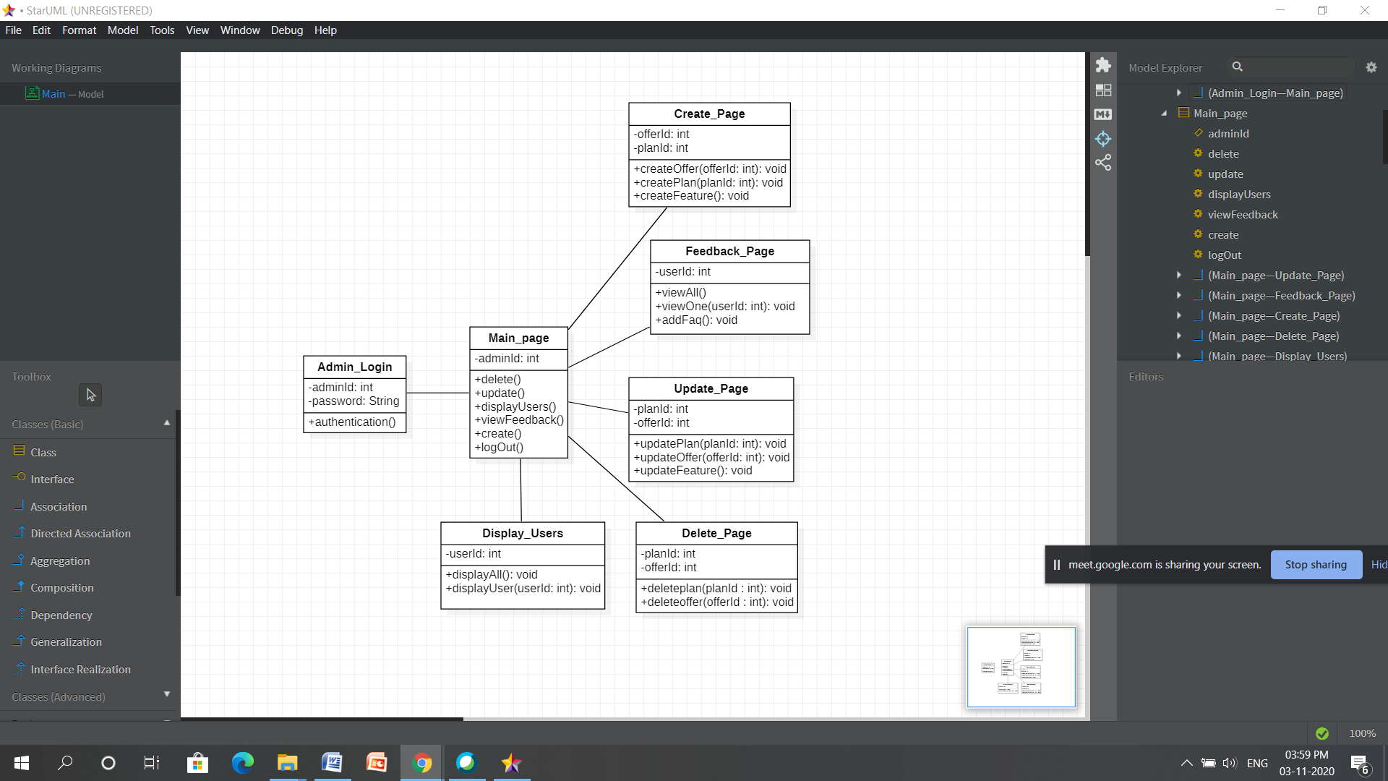
Class diagram of Admin

Slide 9
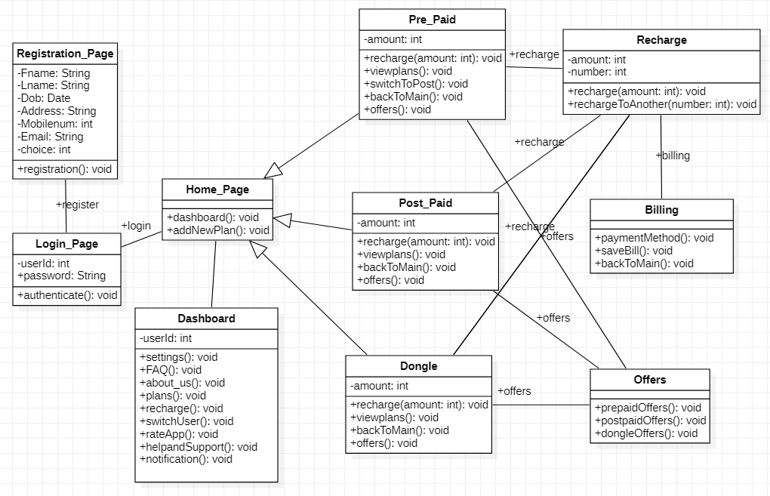
Class diagram of User

Slide 10
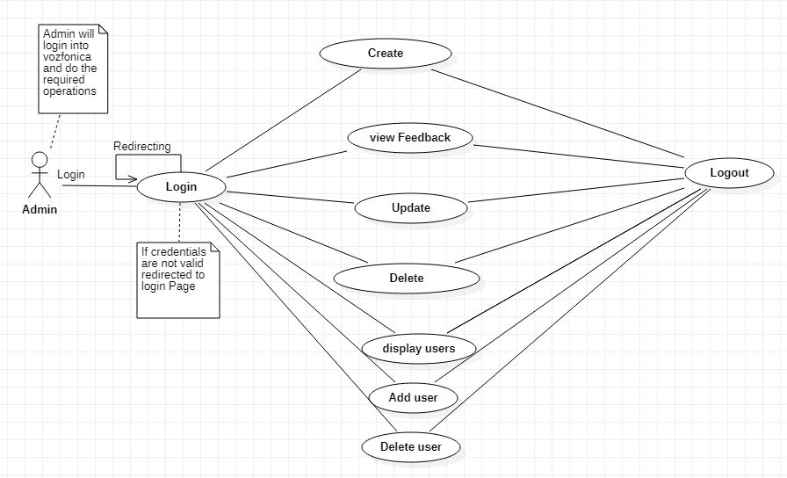
Use case diagram of Admin

Slide 11
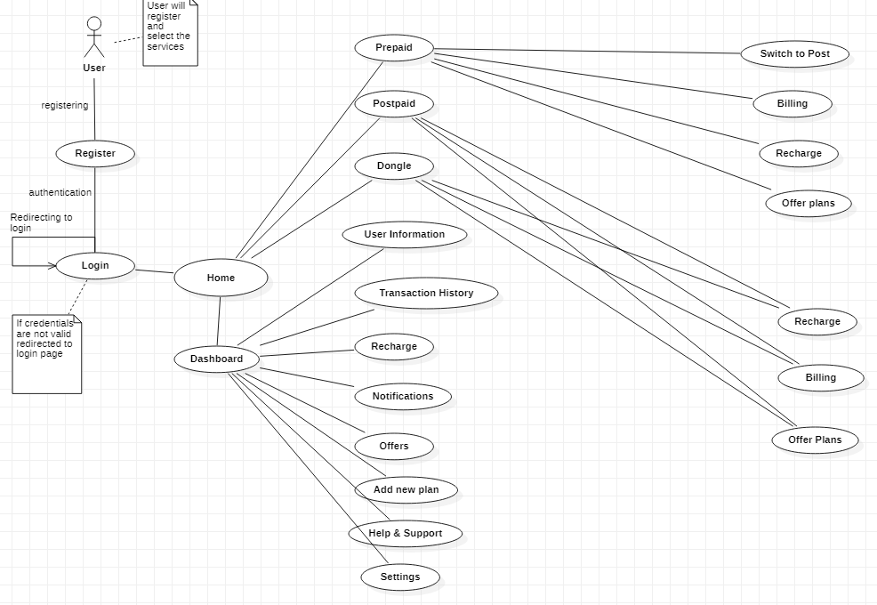
Use case diagram of User

Slide 12
THANK YOU

